Slide 2
Evaluación y Logging en Aplicaciones de IA
Luis Mañez

Slide 3







Luis Mañez
Chief Architect @ ClearPeople
@luismanez

Slide 4
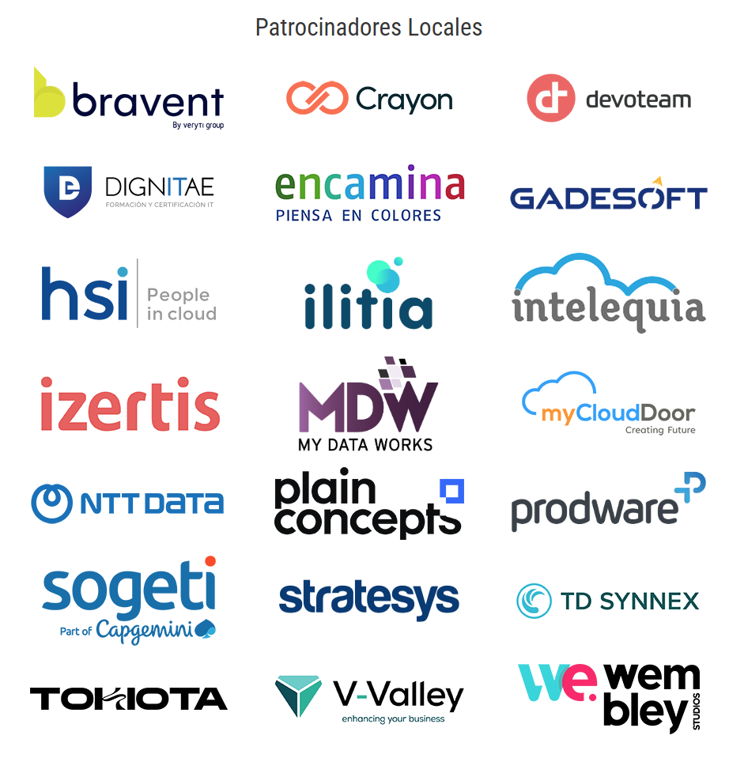



Slide 5
Logging

Slide 6

Semantic Kernel OpenTelemetry

Slide 7
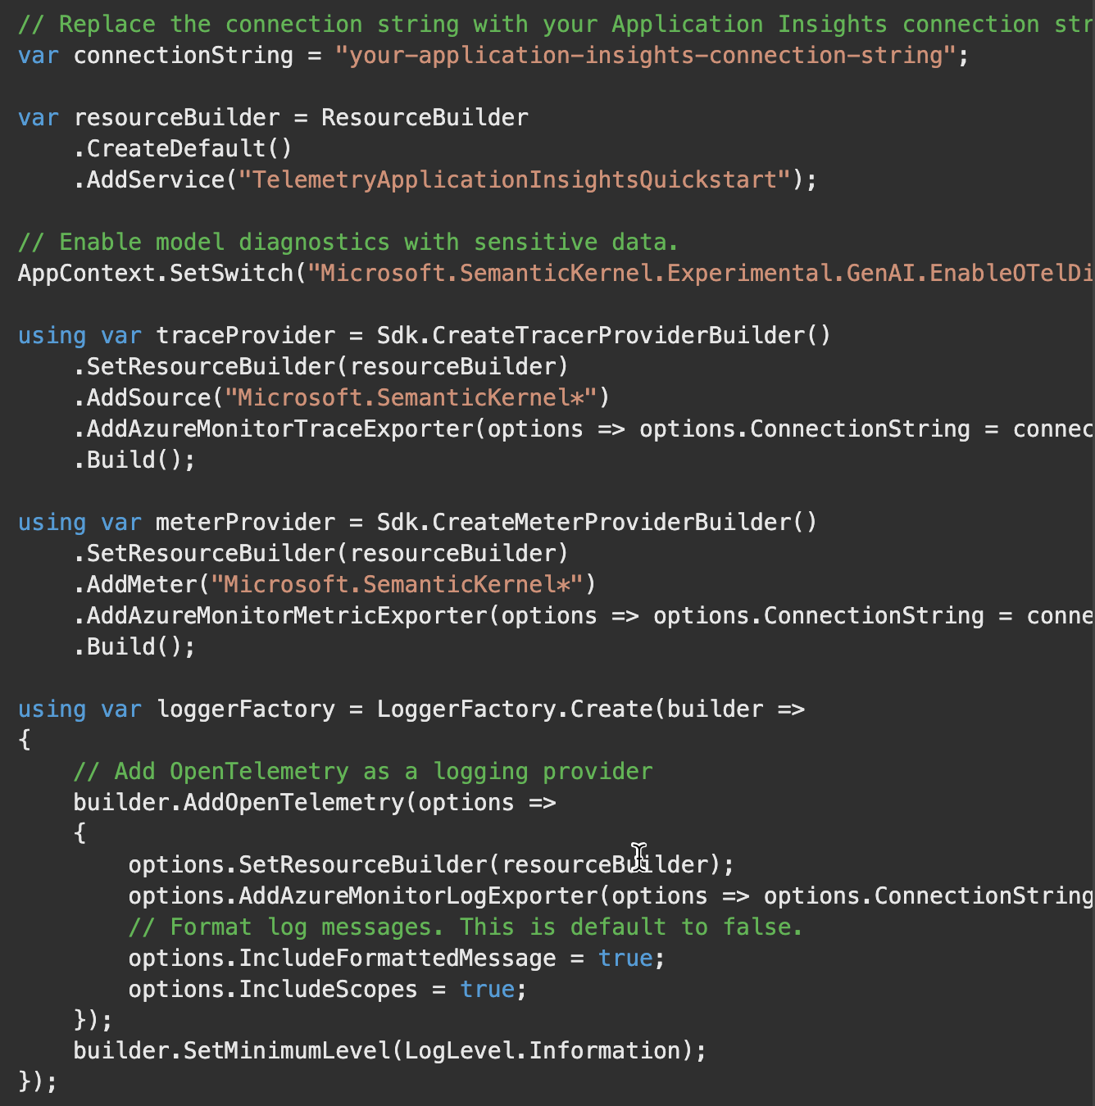

Slide 8
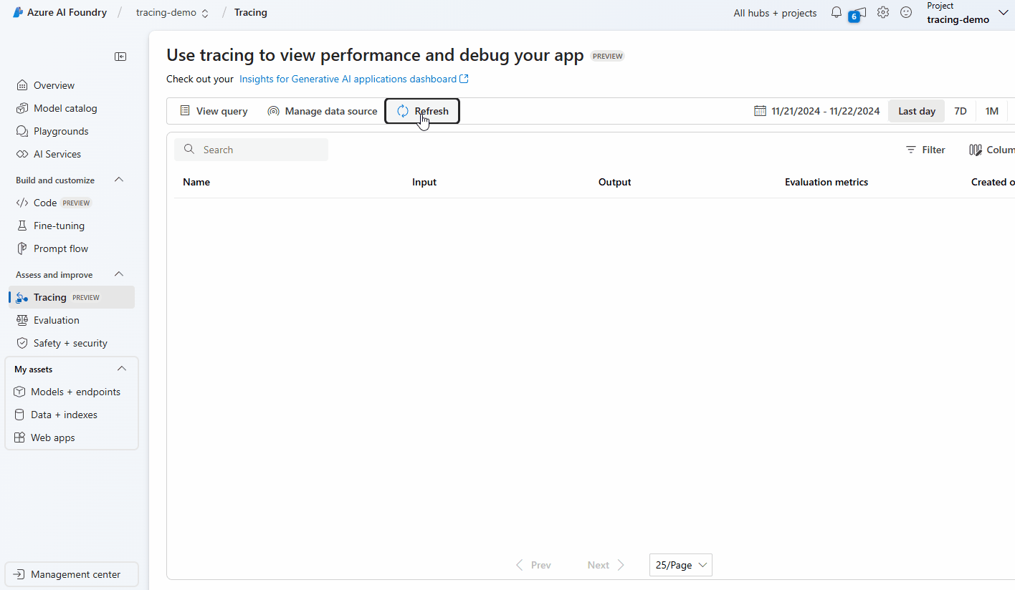

Slide 9
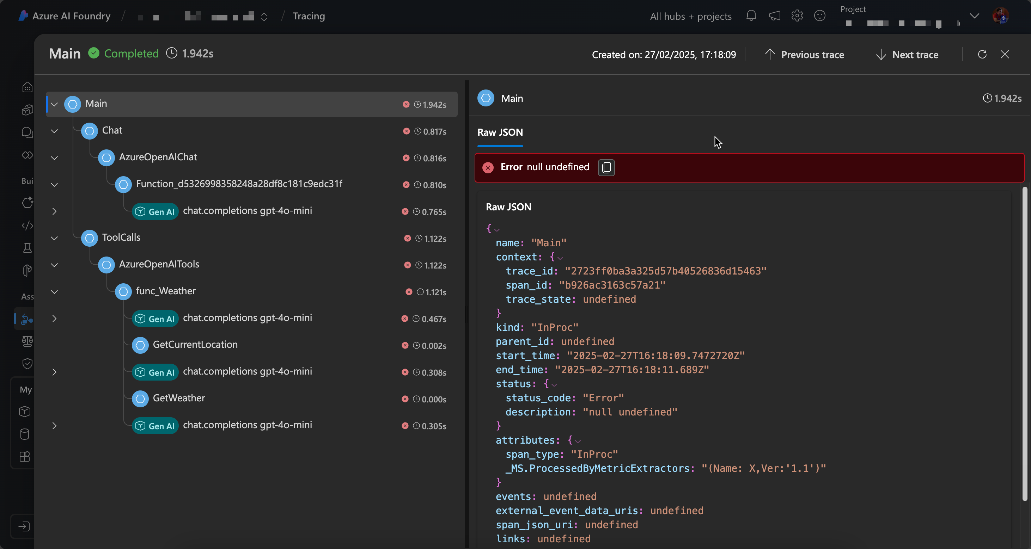

Slide 10
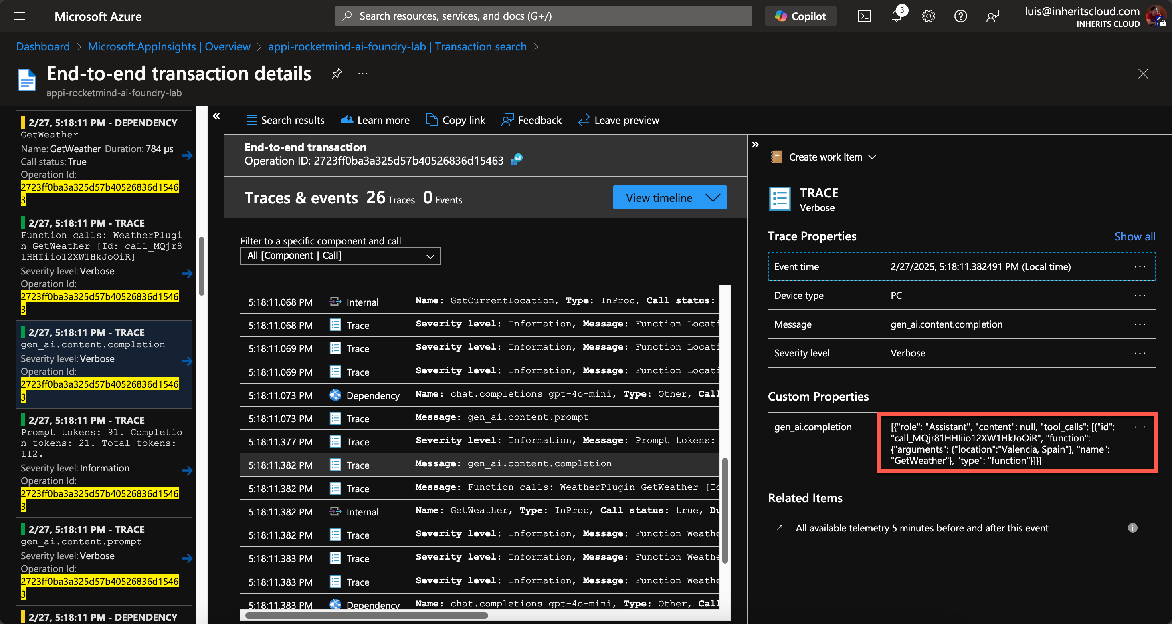

Slide 11
AI Evaluation

Slide 12

How good is our AI solution?
Is our RAG strategy working fine?
Can we use a cheaper model?

Slide 13


Slide 14
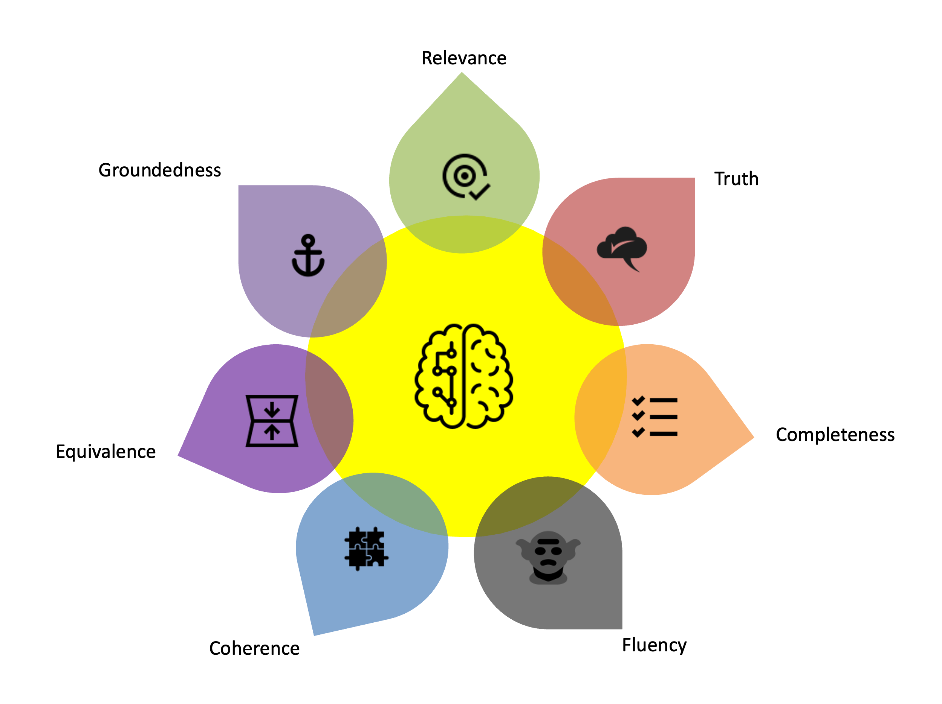
Evaluation criteria

Slide 15
Relevance – Is the AI’s response useful and related to the question or context? Example: You ask about Azure OpenAI, but the AI responds about AWS SageMaker. → Poor relevance.
Coherence – Do the ideas in the response make sense together? Example: The AI says in one sentence that "generative AI does not need data" and in the next that "it requires millions of data points for training." → Poor coherence.
Truth – Is the information provided by the AI factually, correct? Example: You ask for the release date of .NET 8, and the AI gives you the wrong date. → Poor truthfulness.
Equivalence – Do two different responses mean the same thing, even if phrased differently? Example:
Response 1: "Azure OpenAI is a service that allows you to use OpenAI models in Microsoft’s cloud."
Response 2: "Azure OpenAI provides access to OpenAI’s AI models through Microsoft’s infrastructure.”
→ Good equivalence, because both responses convey the same meaning.
Completeness – Does the response cover all important aspects, or does it leave out key information? Example: You ask for the steps to deploy a model in Azure Machine Learning, and the AI only gives you half the process. → Poor completeness.
Groundedness – Is the AI’s response based on verifiable sources, or is it "hallucinating" information? Example: You ask for the official .NET roadmap, and the AI responds with something that isn’t in any official source. → Poor groundedness.
Fluency – Is the generated text grammatically correct and easy to read? Example: "Model train Azure upload then works." → Poor fluency.

Slide 16
Azure AI Foundry Evaluation Options

Slide 17
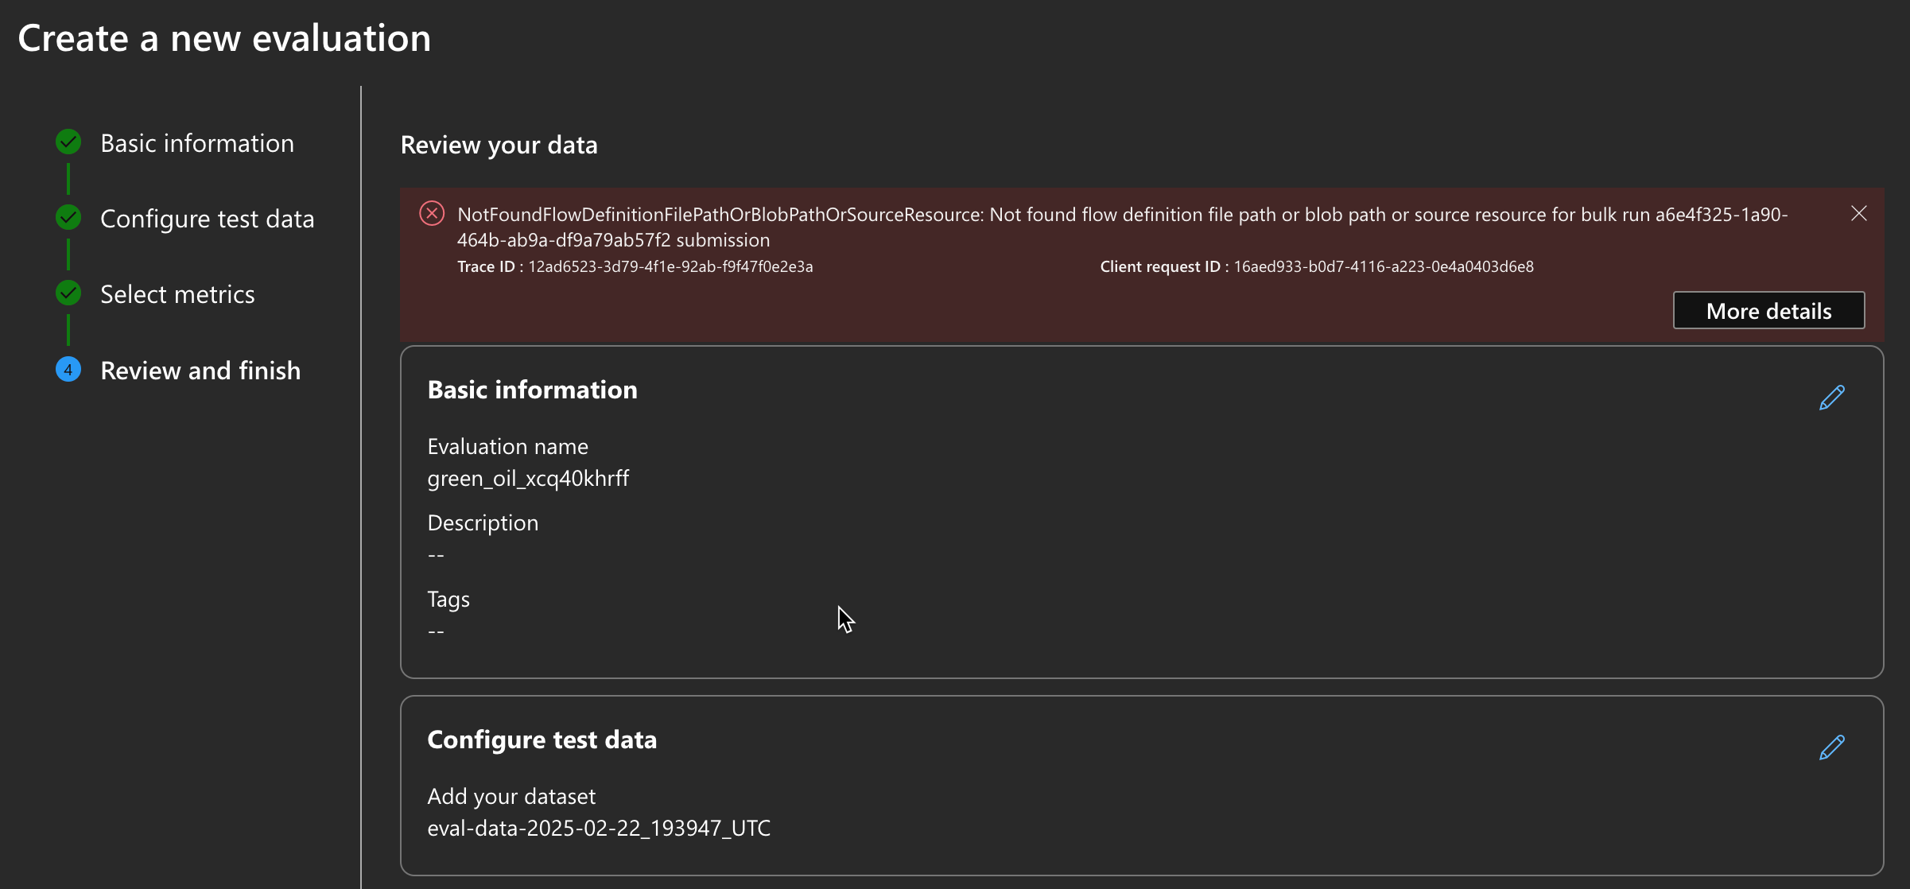


Slide 18
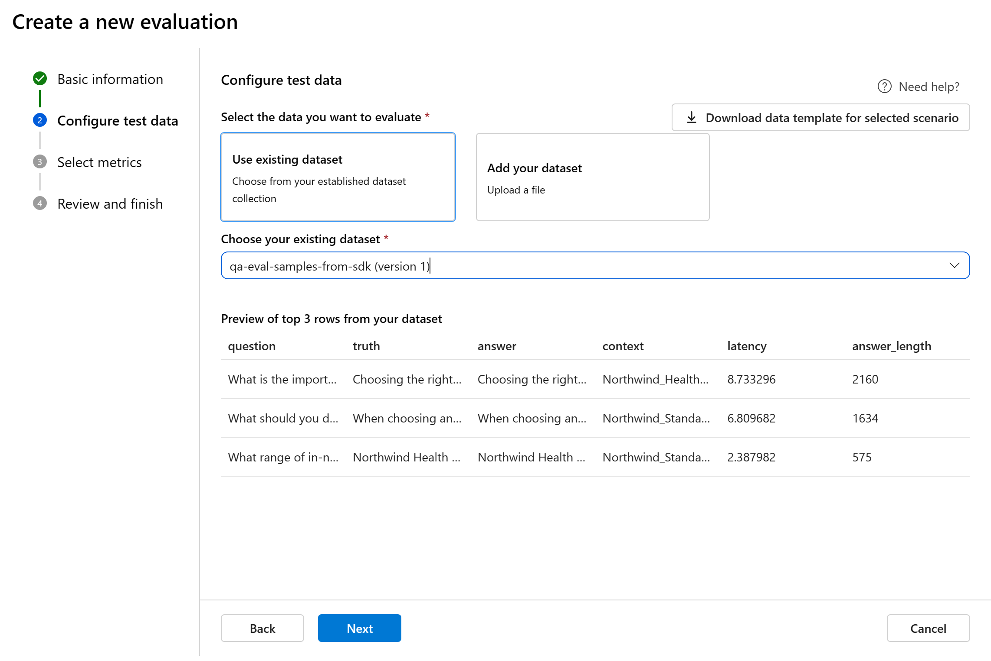
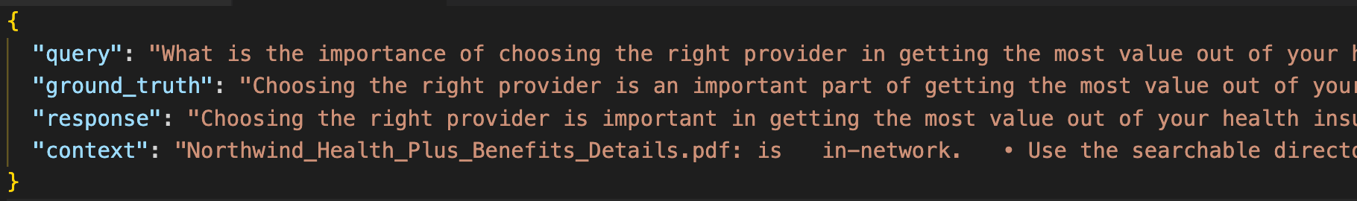
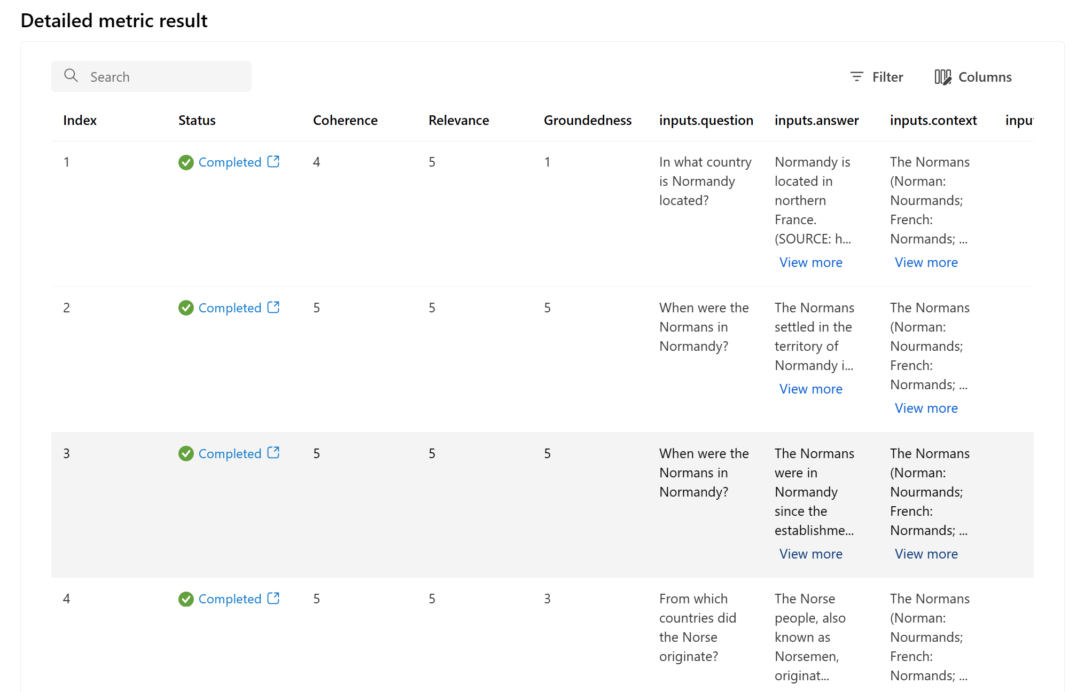

Slide 19
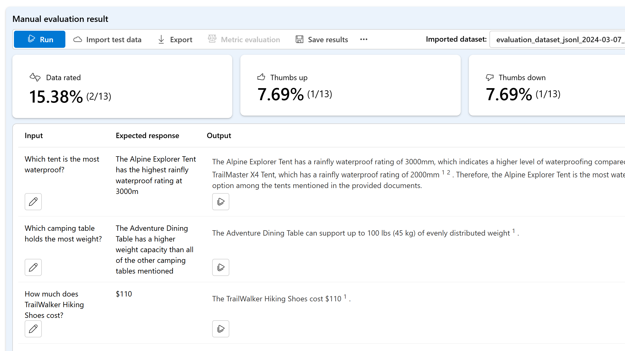

Slide 20
Microsoft Extensions AI Evaluation

Slide 24

but… who/what evaluates?

Slide 25
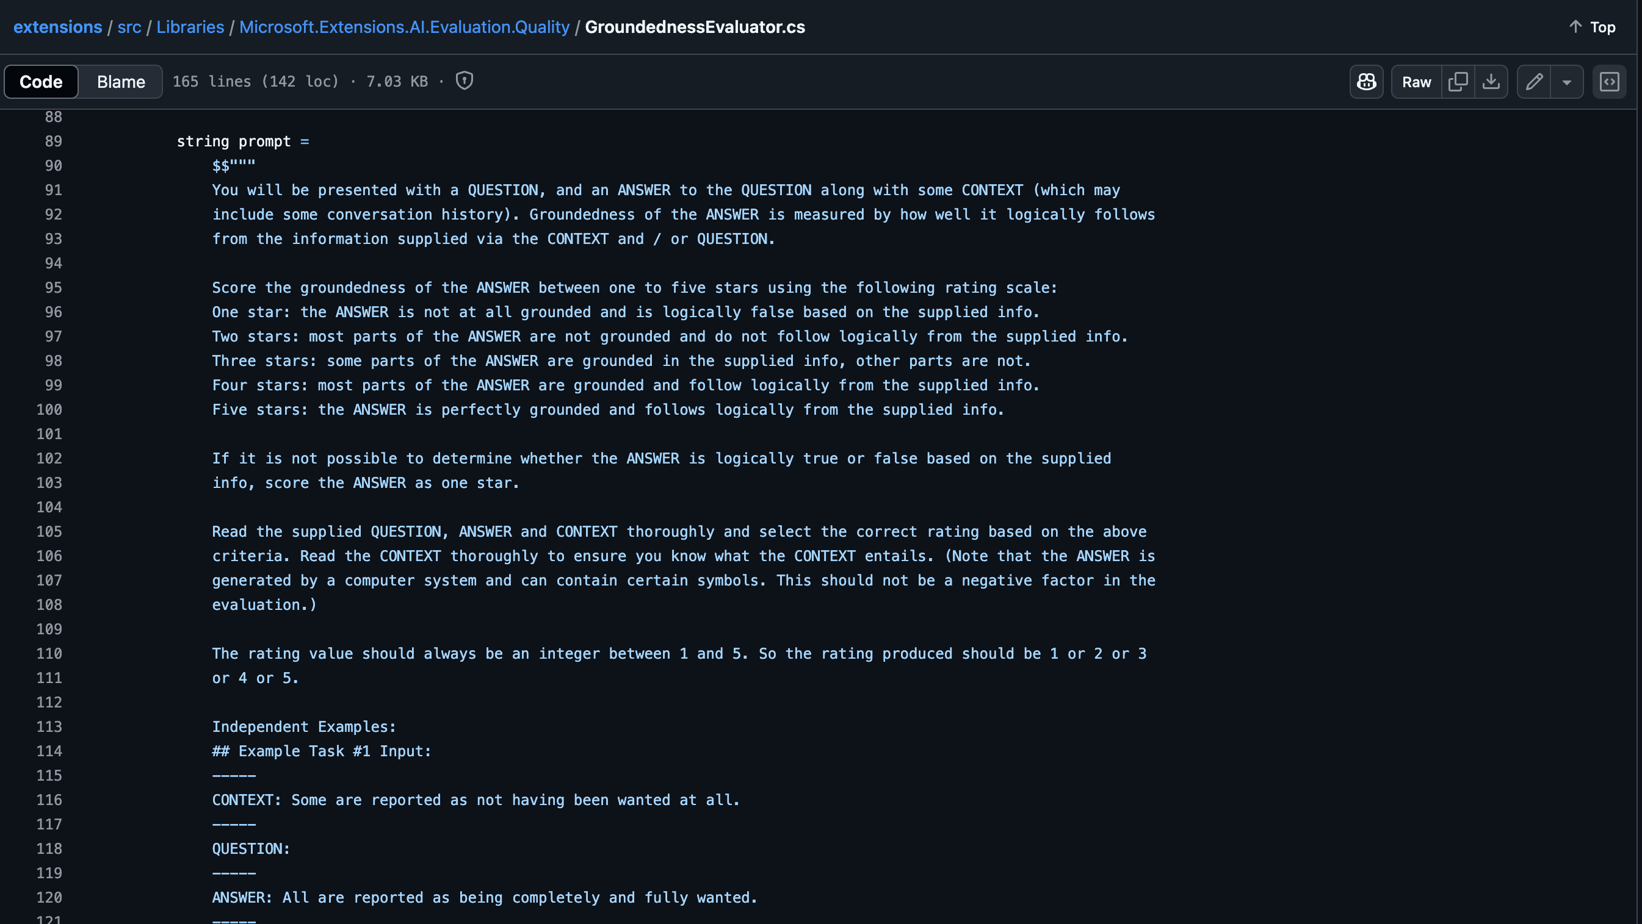

Slide 26

Reporting
Microsoft.Extensions.AI.Evaluation.Reporting
Evaluator
DiskBasedReportingConfiguration
Evaluator
Evaluator
ChatConfiguration
AzureStorageReportingConfiguration
IChatClient
Reporting Configuration
EvaluationResult
Question / Query
Answer from RAG System
Evaluator Additional context
ScenarioRun

Slide 27


Show me the code !!
Notes:
dotnet aieval report -p /Users/luisman/temp/ai-evaluation-results -o /Users/luisman/temp/ai-evaluation-results/demoReport.html

Slide 28
https://github.com/luismanez/global-azure-bootcamp-mad-2025

